Slide 1
Linux System Call Tracer
Guided By: Dr. Alekhya D

Slide 2
Problem Statement
Develop a utility that monitors, captures, and logs system calls invoked by a selected target process during its execution for analysis and debugging.

Slide 3
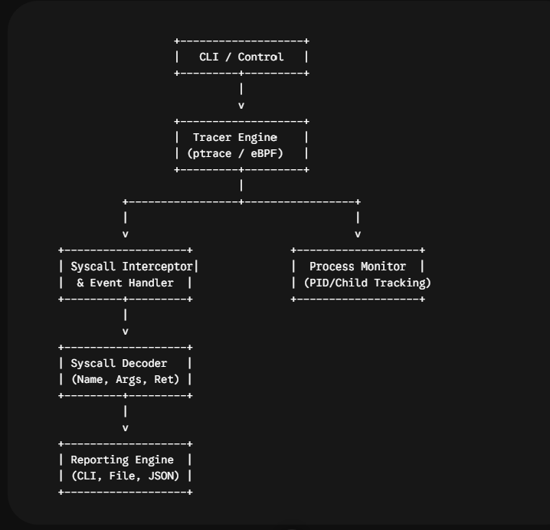
System Design

Slide 4
Implementation Approach
To implement the Linux system call tracer using ptrace, spawn or attach to a target process and pause it at every system call boundary using waitpid and PTRACE_SYSCALL. Alternate between syscall entry and exit stops to read CPU registers via PTRACE_GETREGS, extracting the system call number from orig_rax, arguments from rdi through r9, and return values from rax. Use PTRACE_PEEKDATA to read memory addresses such as path strings from the target process space, translate the system call numbers and error return codes into readable names and error messages, format the intercepted details, and continuously stream the decoded output to stdout or a designated log file.

Slide 5
Technologies Used
The primary technologies used to build a Linux system call tracer include C or C++ for low-level memory control, the Linux ptrace API for process interception, Linux system headers like sys/ptrace.h and sys/user.h, the proc filesystem for direct process memory access, eBPF with libbpf for high-performance tracing alternative, GCC or Clang for compilation, Make or CMake for build automation, and optionally cJSON or libjson-c for structured logging output.

Slide 6
Testing
Testing the tracer involves running synthetic C binaries with known system call sequences like open, read, write, and exit to verify argument accuracy. Compare output directly against standard strace execution logs for identical commands to validate system call accuracy. Test process handling using fork, execve, and clone to confirm multi-process tracking, trigger failing calls to verify negative error code decoding, and send signals such as SIGINT or SIGSTOP to ensure clean process termination without deadlocks or orphans.

Slide 7
Results
The tracer results demonstrate real-time event capture with accurate parameter decoding, exact path string extraction, and precise error code mapping. Comparative benchmarking against strace shows minimal CPU overhead and low execution latency impact on monitored targets. Process tracking reliably follows fork, execve, and multithreaded transitions without losing context, while signal interception manages process interruptions and terminations cleanly without leaks.

Slide 8
Impact
The impact of the Linux System Call Tracer includes providing clear visibility into application behavior, reducing debugging time for complex kernel-level interactions, and improving security auditing by flagging unauthorized or suspicious process activity. It provides developers and administrators with a lightweight, precise tool for diagnosing runtime crashes, resource leaks, and system bottleneck issues without requiring source code access or heavy binary instrumentation.

